Slide 1

HACKFEST 2021
HOME CLEANING ROBOT

Slide 2
IIT ISM DHANBAD
TEAM MEMBERS
1.Tanishq Chaudhary
2.Muntaba Khan
3.Tanishq Mittal

Slide 3
Problem statement

Slide 4
A robot to overcome the problem of sanitation and social distancing.
The solution is the Home Cleaning Robot.
It will be able to perform mopping and cleaning as well as assist in bringing things to any place.

Slide 5
SOLUTION

Slide 6
We came up the idea of home cleaning bot to solve the problem of day to day life.
In these difficult days of pandemic, the robot will help us to ensure proper sanitation and
also of social distancing.
It can well serve the purpose of zero contact delivery.

Slide 7
PICTORIAL PRESENTATION

Slide 8
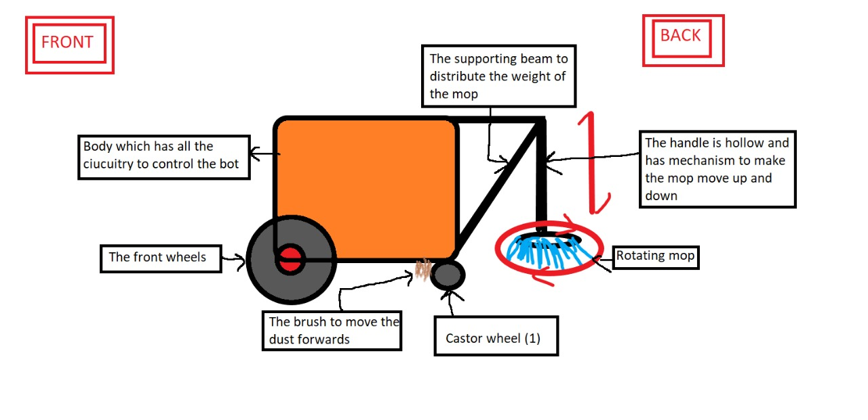

Slide 9
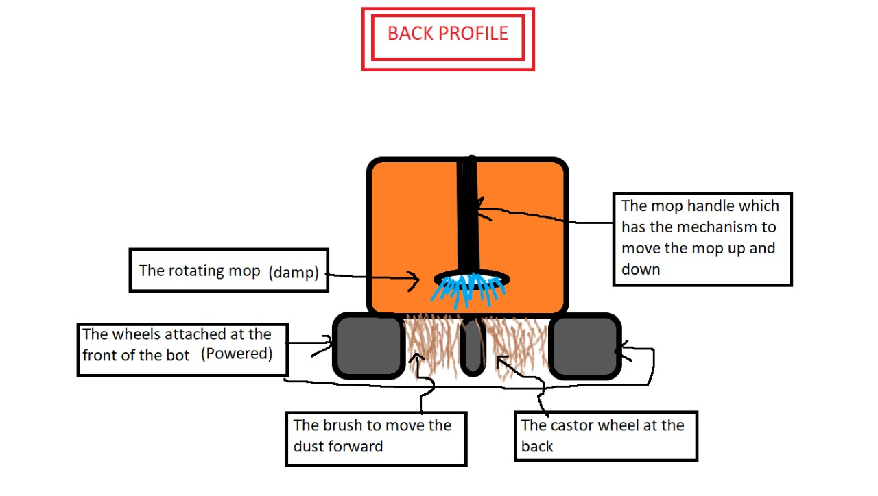

Slide 10
MATERIAL REQUIRED

Slide 11
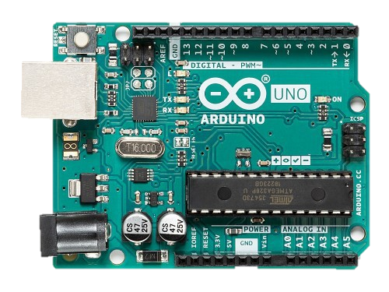
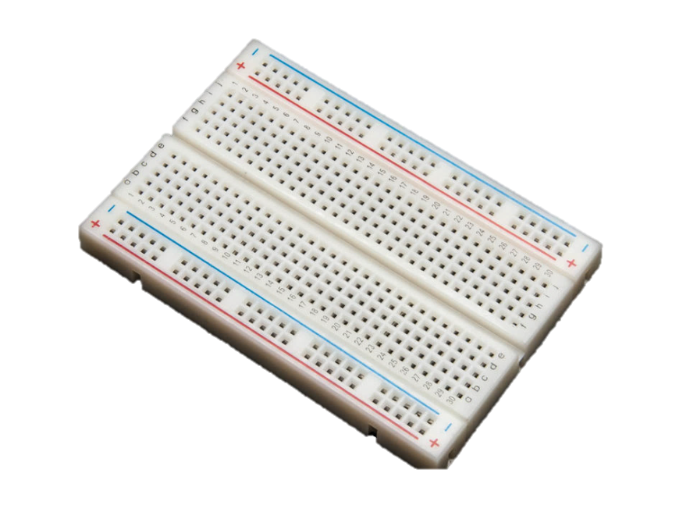
ARDUINO UNO :
The Arduino Uno is an open-source microcontroller board based on the Microchip ATmega328P microcontroller.
We have used it for the execution of codes.
1X Arduino board
PRICE = 499
BREADBOARD:
Used for connections.
Breadboard
PRICE = 65

Slide 12
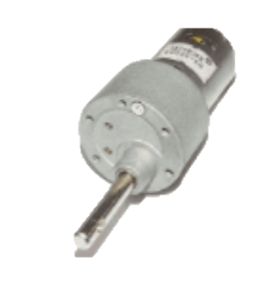
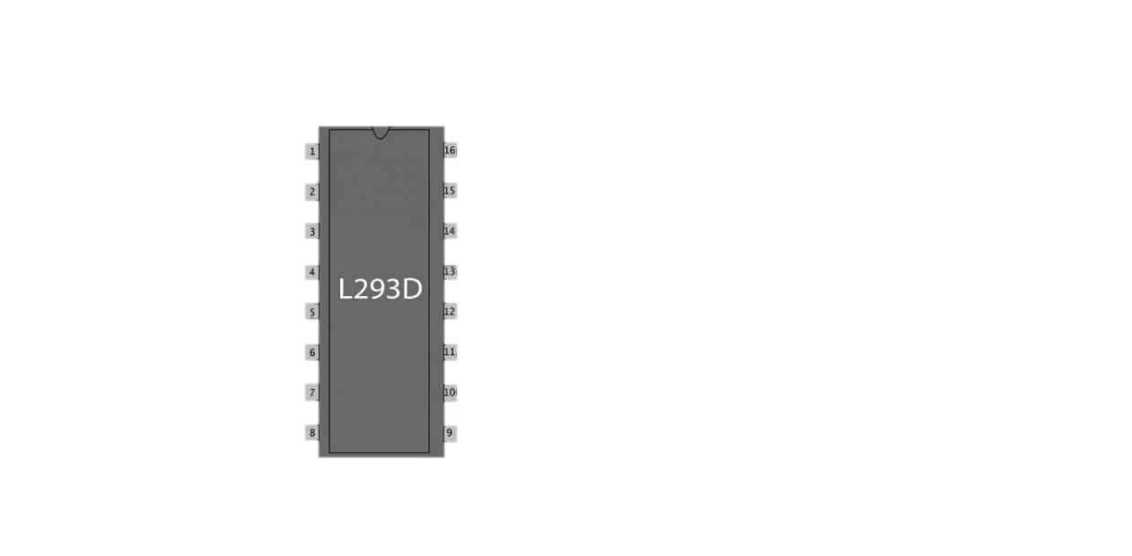
Johnson geared motor
Used for movement of wheels and mop rotation.
3X Johnson Geared Motor
PRICE = 3 X 384=1152
L293D Motor Driver
An integrated circuit chip used as a motor controlling device in autonomous robots and embedded circuits.
2X L293D Motor driver
Price =2X 69=138

Slide 13
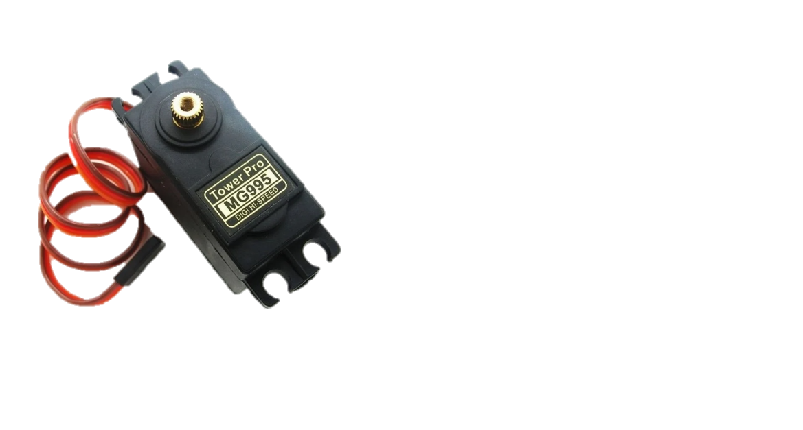

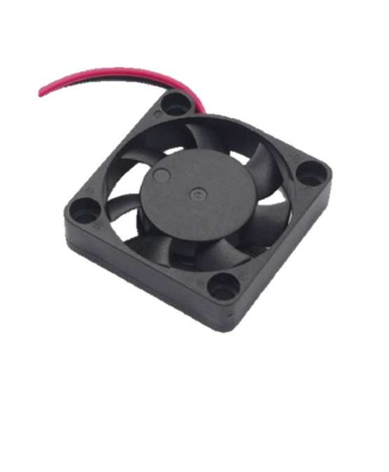
Servo Motor
This motor is used for the up and down motion of mop.
1 Servo Motor
Price = 225
Heat sink
To prevent the damage from excessive heating.
2 X Heat sink
Price = 2 X 60=120
Li Ion Battery
1 Li- ion 6000mAh 7.4V
Price=1449

Slide 14
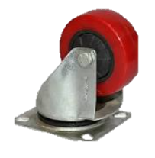
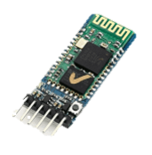
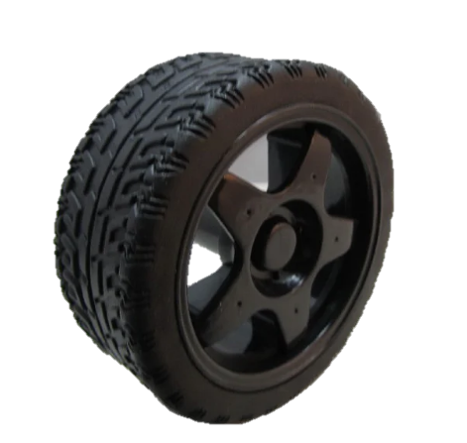
Castor wheels
For the support to the front of robot.
Price = 175
HC05 Bluetooth Transceiver Module with TTL Output
Price = 299
Off road wheels
2X Off road wheels
Price =2X 72=144

Slide 15
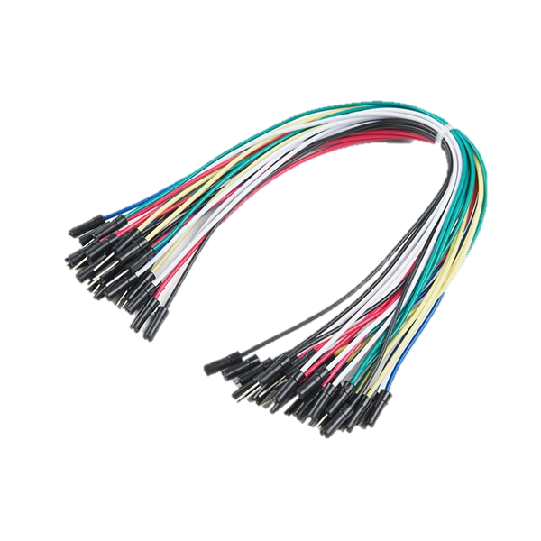


Jumper wires/ Open wires
Price = 64
1 MOP
Price = 199
Sheet metal and support

Slide 16
Cost of the robot is approximated to- Rs.5200

Slide 17
WORKING PRINCIPLE

Slide 18
Working principle of the bot
Our robot comprises of various types of elements which are a performing a significant role in overall excellence performance of the bot.
We have used servo motors for performing tasks like mopping and cleaning. This highly efficient motors enable the bot to move the mop in a fixed manner of up and down with pre specified angles and measurements .It will be instructed with help of Arduino programming feeded in the board.
Robot is powered with Lithium-ION battery. This enables the functioning of motors and wheels. Off-road wheels are used for the movement. These are connected with Johnson Geared motor powered by battery.
The development board , PCB and Exhaust fan are placed inside the bot .
Also with the help of heat sink ,the internal system can be protected from overheating and getting burned.

Slide 19
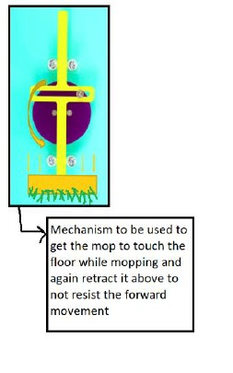

Slide 20
CIRCUIT DIAGRAM

Slide 21
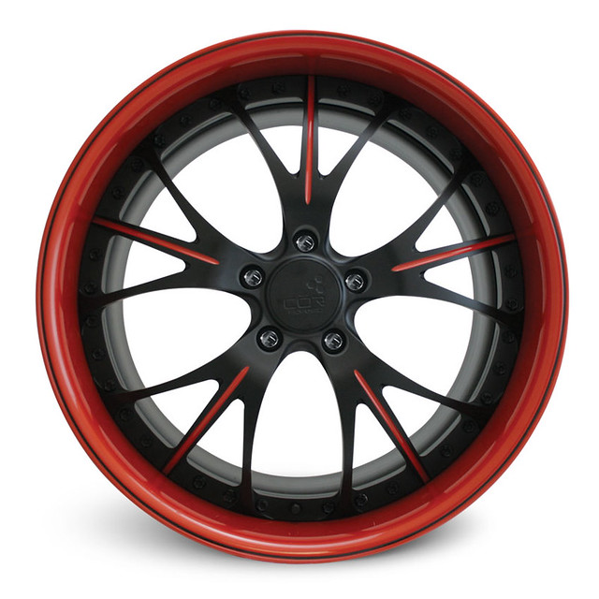
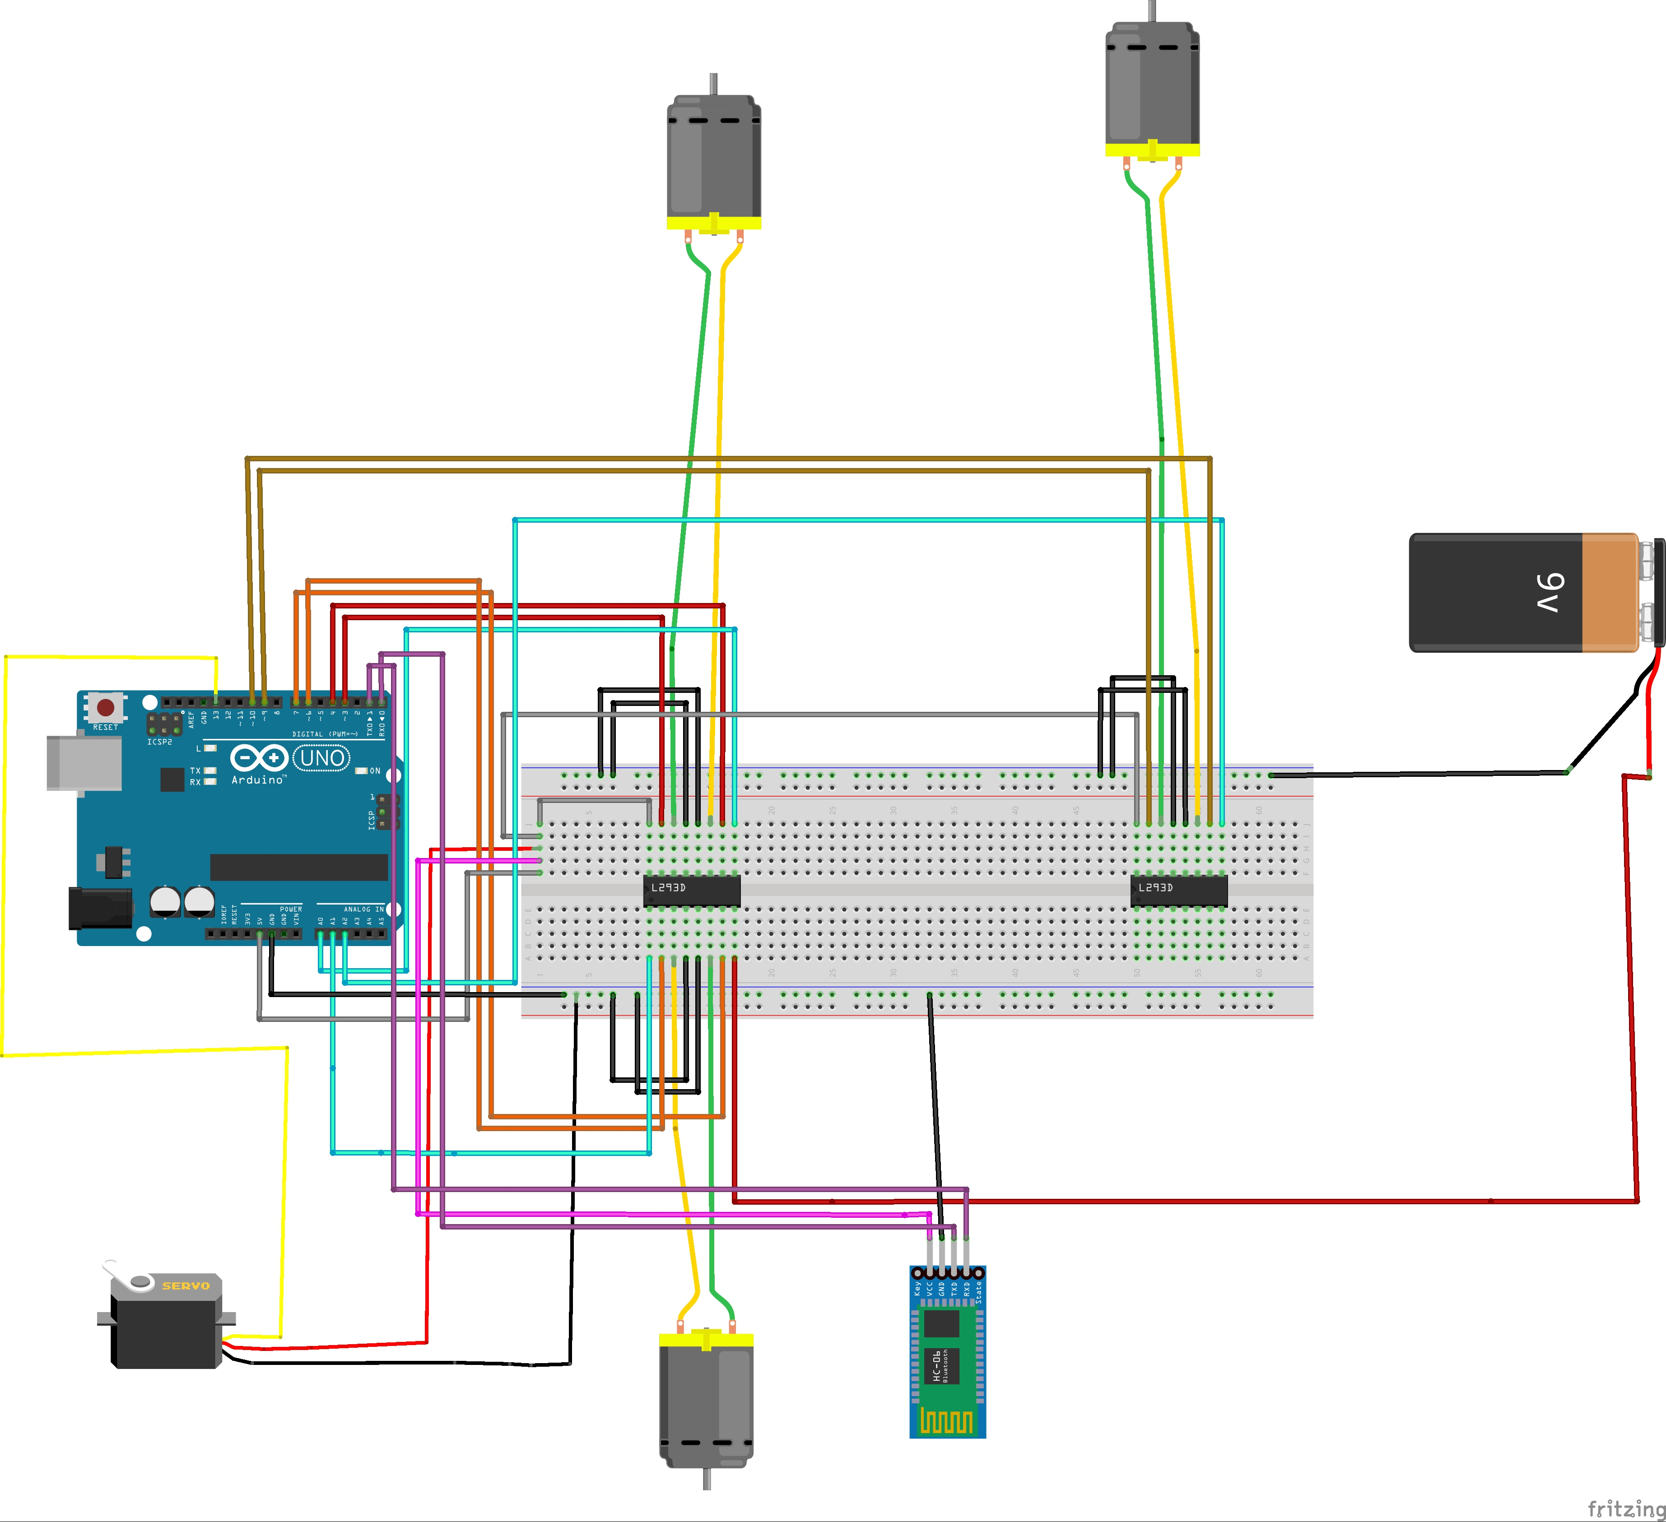
PDF of circuit diagram

Slide 22
CONCLUSION

Slide 23
This way our robot has its efficiency and utility.
The working principle highlights the use of various components used.
Our robot is also cost efficient and accessible to the common man.

Slide 24
THANK YOU

